Slide 1

Lesson 2 - Introduction to Authorization PDP GE’s API
FIWARE Chapter: Security
FIWARE GE: Authorization PDP (current version: R5)
FIWARE GEri: AuthzForce (current version: 5.4.1)
FIWARE GE Owner: Cyril Dangerville, Thales Services
Notes:
Hello, my name is Cyril Dangerville
this is the second lesson in the series on the Authorization PDP Ge. In the previous lesson, I introduced you to this Generic Enabler. In this lesson, I will make a focus on the API as it is defined in the FIWARE Open spec of the GE

Slide 2
Goals of this lesson
Introduce the Open API of Authorization PDP GE
Core specification: OASIS XACML standard
Domain management API
PAP API
PDP API
Give pointers for more info
Introduce next lessons

Slide 3
GE API based on XACML standard
Why XACML?
Need for ABAC to cope with RBAC limitations → Lesson 1
Fact: enterprise security policy (if exists) managed in different places (HR, Legal, Finance, IT, etc.), enforced in many points: network access, mail, intranet, business apps, etc.
→ Assurance that your enterprise access control policy (including “best practices”) is consistently applied globally is VERY VERY HARD to get when using different technologies and languages everywhere
Where to start?
Common language for expressing security policy
Common language for authorization decision request-response format
OASIS standard answer: XACML (eXtensible Access Control Markup Language)
Other related standardizations:
IETF Policy Framework Working Group
Distributed Management Task Force (DMTF)/Common Information Model (CIM) (RFC3198)
ISO10181-3 (Access Control Framework)

Slide 4
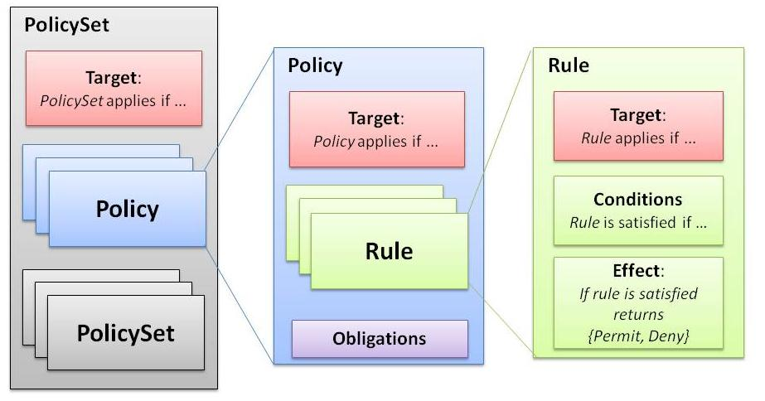
XACML Policy Language

Slide 5
XACML Decision Request
XACML Request
….
Category X
Attribute Y
Category Subject
Attribute ID
(subject-id, subject-role, …)
Attribute Y
Category Resource
Attribute Value
(romain, 1970-01-01, …)
Category Action
Attribute Type
(string, date, integer, …)
Category n

Slide 6
XACML Decision Response
Decision: Permit/Deny/Indeterminate/…
Obligation(s): orders given to the PEP requesting the decision
Examples:
Send an alert to some admin
Log the access request somewhere
…

Slide 7
API uses v3.0 of XACML which improves over v2.0
More advanced and flexible Target matching capabilities
Custom attribute categories (limited to Resource, Action, Environment and a few Subject categories in v2.0)
Dynamic Obligations using variables evaluated at runtime (limited to static values in v2.0) from request context after possible transformations by XACML functions
Obligations in Rules (limited to Policies and PolicySets in v2.0)

Slide 8

GE specification – Domain management API
RESTful
Domains: /domains
Create domain
POST /domains
Body: domain properties (externalId, description)
Get domain sub-resources
GET /domains/{domainId}
Update/Get domain properties
PUT/GET /domains/{domainId}/properties
Delete domain
DELETE /domains/{domainId}

Slide 9
GE specification - PAP API - Policies
RESTful
Each domain/tenant has a PAP for managing policies: /domains/{domainId}/pap
Add a policy (a version of a policy)
POST /domains/{domainId}/pap/policies
Body: XACML <PolicySet>
Get a version of a policy (e.g. v1.0 of policy P1)
GET /domains/{domainId}/pap/policies/P1/1.0
Remove a version of a policy
DELETE /domains/{domainId}/pap/policies/P1/1.0
Get all versions of a policy
GET /domains/{domainId}/pap/policies/P1
Remove all versions of a policy
DELETE /domains/{domainId}/pap/policies/P1

Slide 10
GE specification - PAP API – Policy references
Policy references:
Policy P1 (v1.0) available: /domains/{domainId}/pap/policies/P1/1.0
Add Policy P2 referencing P1: POST /domains/{domainId}/pap/policies
<PolicySet PolicySetId=“P2” …>
…
<PolicySetIdReference Version=“1.0”>P1</PolicySetIdReference>
…
</PolicySet>
‘Version’ is optional in the reference (latest version used if none specified)

Slide 11
GE specification - PAP API – PDP properties
Each domain/tenant has a PDP for requesting authorization decisions
PDP properties:
PUT /domains/{domainId}/pap/pdp.properties
Body: pdpPropertiesUpdate: rootPolicyRef & features
rootPolicyRef: PDP needs a root policy to know where to start the evaluation
features: GEi-specific PDP features

Slide 12
GE specification – PDP API
RESTful (XACML REST Profile)
PEPs send authorization decision requests with:
POST /domains/{domainId}/pdp
Body: XACML Request
Response: XACML Response

Slide 13
Where to go next?
Official Authorization PDP GE’s API specification
Text description (from APIary blueprint)
Technical description (standard WADL)
Lesson 3: Introduction to the GEri AuthzForce
Everything you need to know about the GE & GEri is on the FIWARE catalogue (link)

Slide 14
Q & A
Thanks for your attention ☺

Slide 15




XACML Architecture
PEP
ENFORCE
Policy Enforcement Point
AuthZ Request
(XACML)
DECIDE
PDP
Policy Decision Point
INFORM
PIP
Policy Information Point
PIP
PIP
STORE
PRP
Policy Repository Point
MANAGE
PAP
Policy Administration Point
Notes:
The PEP can be a piece of code embeded inside your application, an reverse proxy in front of your application or even in the case of a physical PEP a swipe card reader to access a specific room
The PDP is the component that make the decision (Permit or Deny) based on some attributes and one or multiple policies
The PIP is the point that feed the attributes value to the PDP to help him makes is decision
The PRP store the policies
The PAP is the administration module that allow the administrator to create, read, update and delete the policies

